Slide 1

Fish Species Classification 🐟
Domain : Image Classification /Deep Learning
This tool leverages advanced deep learning models to recognize and identify multiple species of fish from images, making it easy to explore dataset distributions, compare model performance, and perform real-time fish species classification.
Project Highlights:
Classifies fish species using advanced convolutional neural networks.
Visualizes datasets and model metrics interactively.
Allows model selection and real-time prediction from image uploads.
Uses transfer learning and best practices in deep learning.
Technologies Used
🌐Streamlit for interactive web UI
🧠TensorFlow / Keras for deep learning models
📊 Pandas, NumPy for data processing
📈 Matplotlib / Plotly for visualization
About the Author
Name: M.Keerthana
Linkedin

Slide 2
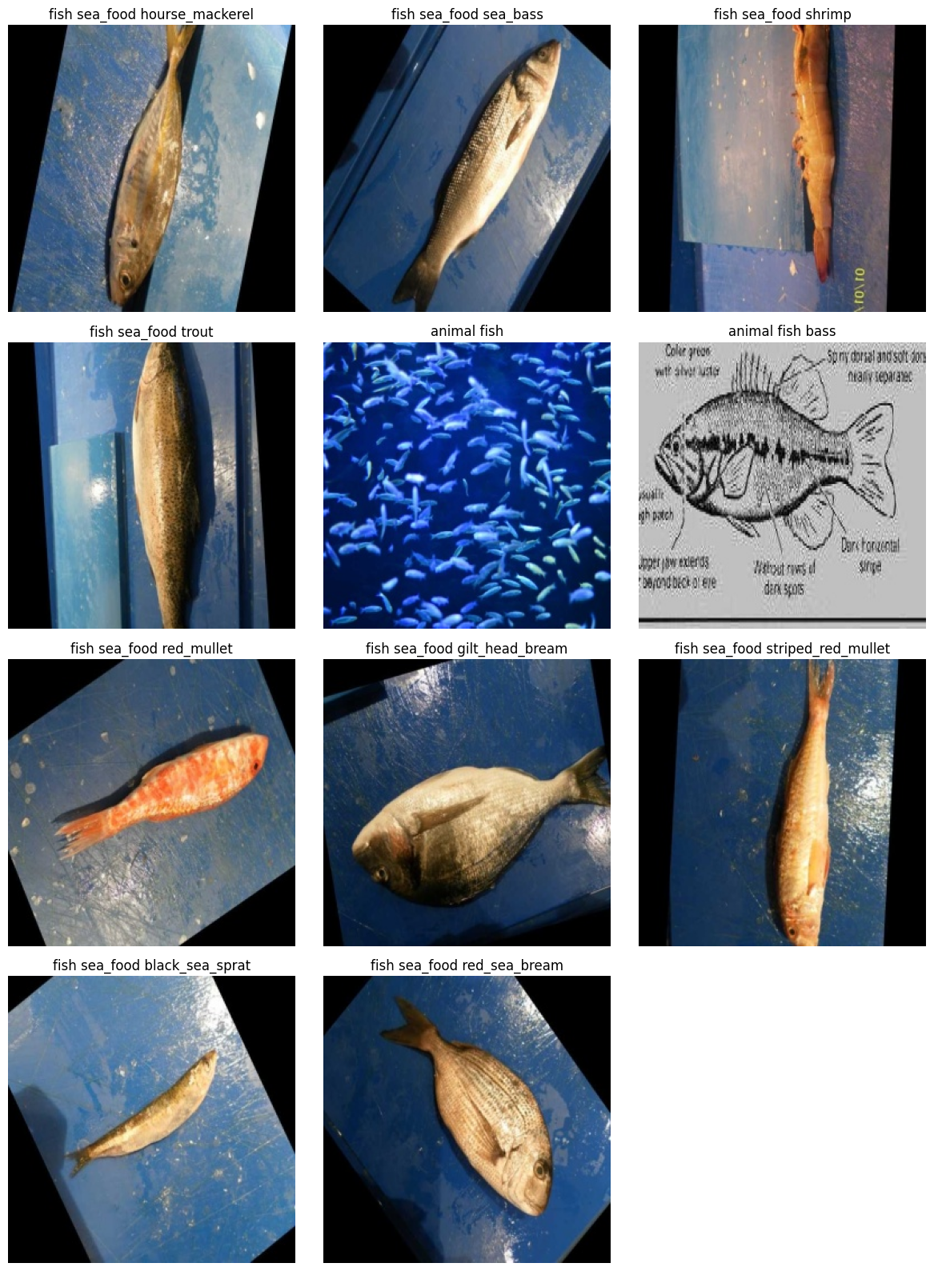
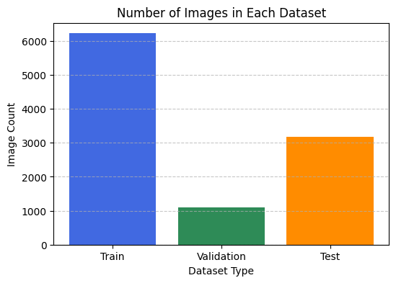
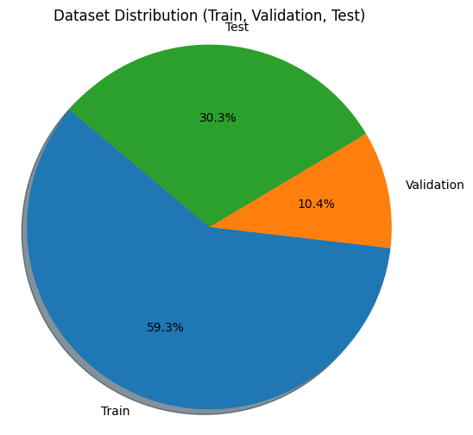
Dataset Overview
The dataset is split into 59.3% training, 10.4% validation, and 30.3% testing, indicating a balanced approach to model learning and evaluation.
The split reflects typical practices for deep learning datasets, prioritizing sufficient training data while reserving significant sets for validation and testing
The sizable dataset helps reduce bias and increases the reliability of the classification results across multiple fish species.
Maintaining a reasonable balance between dataset partitions supports both model accuracy and robust evaluation metrics.

Slide 3
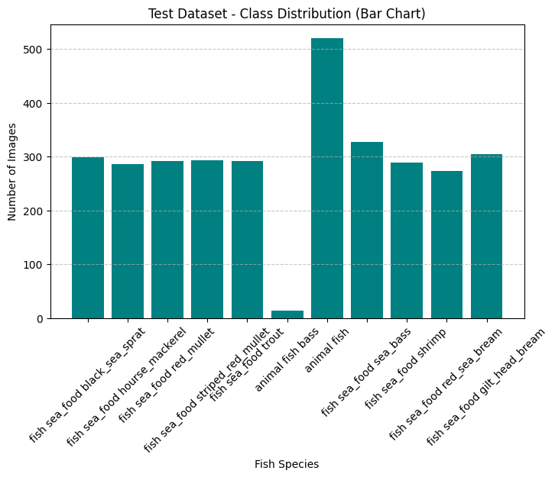
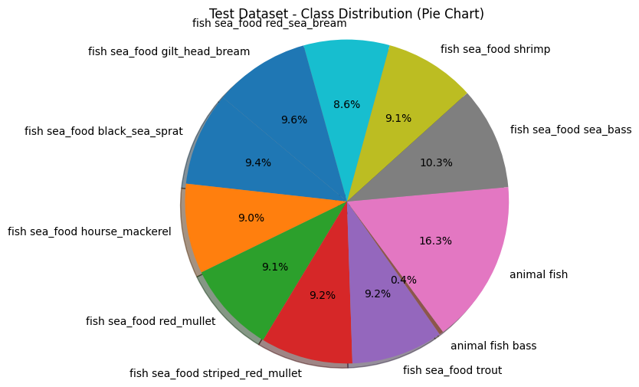
Data Overview-Test
The test dataset shows nearly identical proportions to training and validation — ideal for fair final model evaluation.
Balanced test data ensures performance metrics (accuracy, F1-score) are representative and trustworthy
Consistent class spread reduces evaluation variance and improves cross-model comparability.
This even test distribution confirms a well-engineered dataset pipeline, enhancing the credibility of model results.

Slide 4

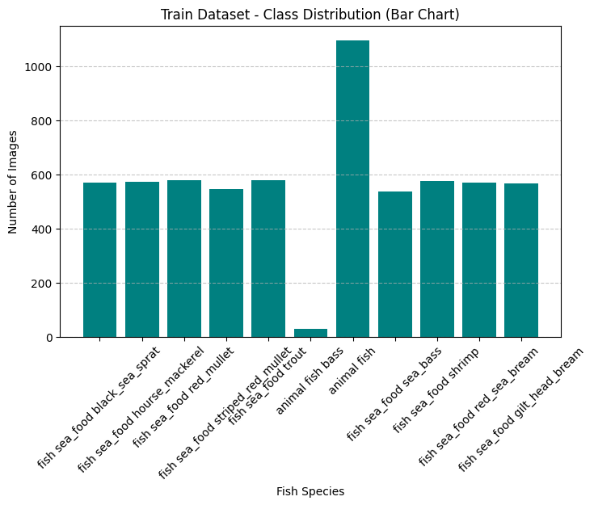
Dataset overview - Train Dataset
The training dataset has the largest sample size — giving each model enough data to learn class-specific features effectively.
The class proportions remain balanced, with most species representing around 8–10% of the data.
The diverse mix (shrimp, bream, trout, etc.) supports a generalized learning process across marine species.
The consistent spread suggests a stratified split was used during data preparation, ensuring class balance in training.

Slide 5
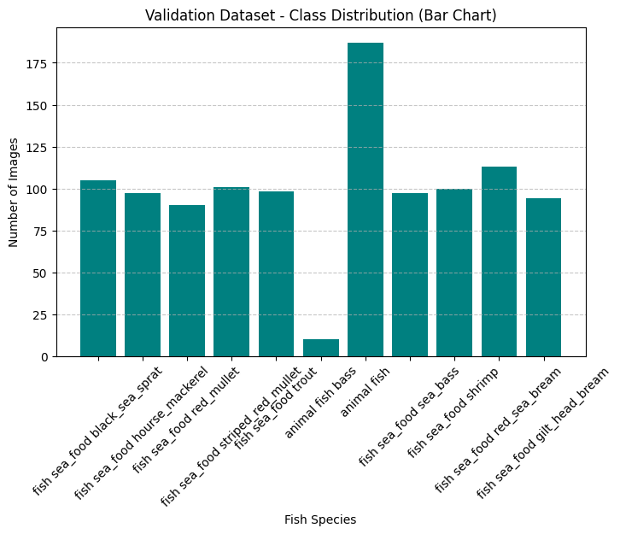
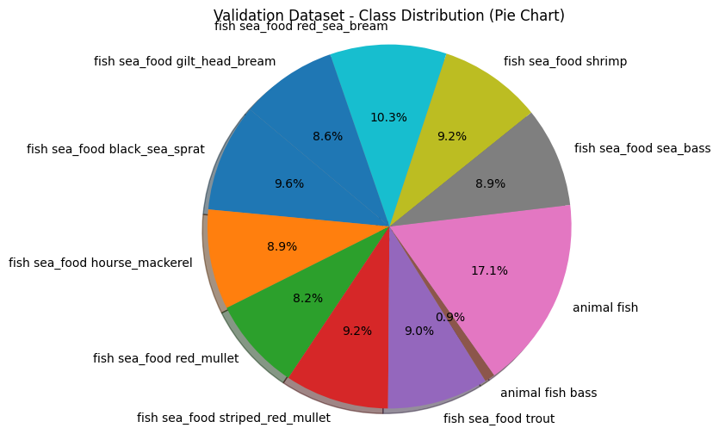
Dataset overview – Validation
The validation dataset mirrors the training set proportions closely, confirming a uniform distribution across splits.
This consistency ensures that performance metrics (accuracy, loss, precision) remain unbiased and reflect true generalization.
The balanced distribution means hyperparameter tuning will reflect real-world accuracy.
Sufficient validation data supports effective early stopping and model selection during training

Slide 6
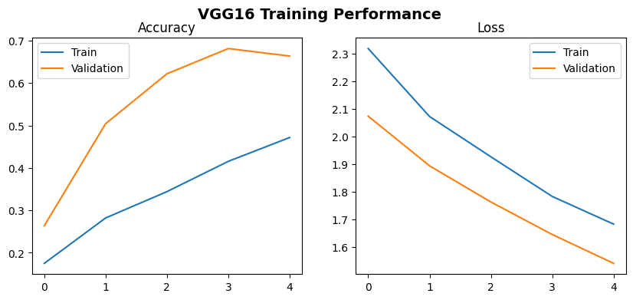
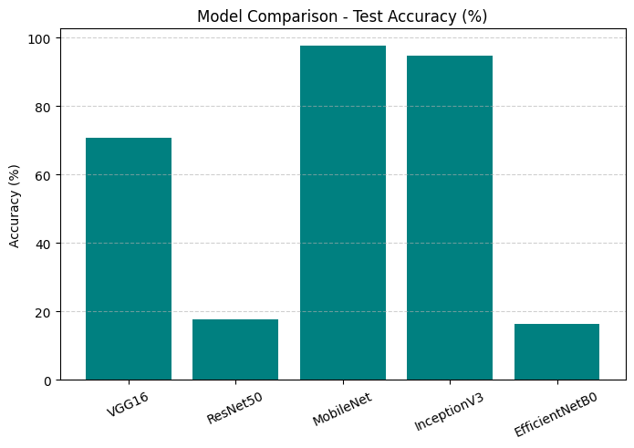
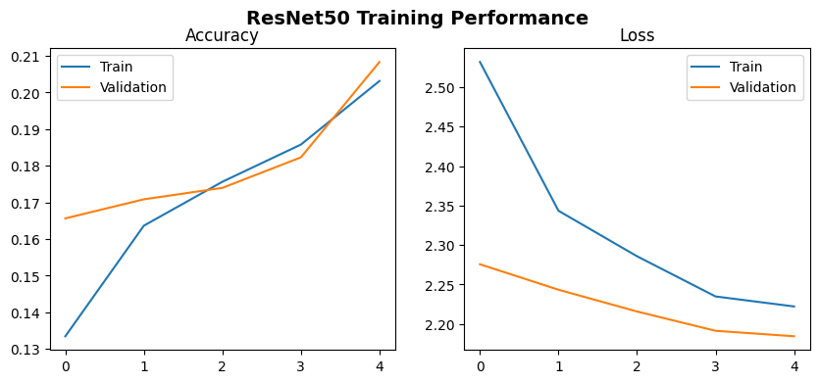
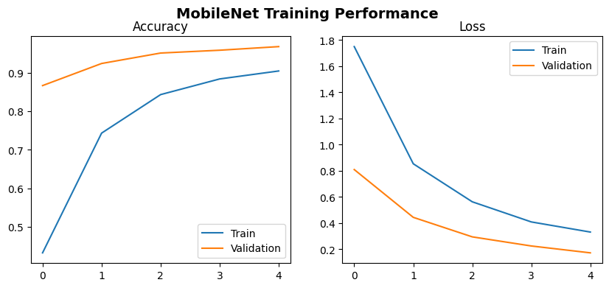
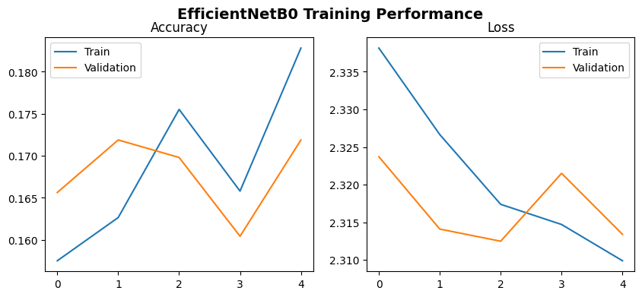
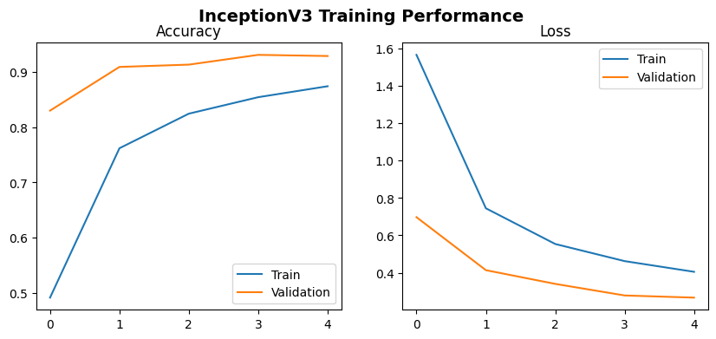
Model Training Performance (Accuracy and Loss)
MobileNet and InceptionV3 clearly outperform other architectures, making them the most suitable models for fish species classification.
Simpler architectures (VGG16) show decent results, while very deep ones (ResNet50, EfficientNetB0) may need further tuning or more data.
Among all models, MobileNet and InceptionV3 achieved the highest test accuracy (~95–98%), demonstrating strong generalization and efficient feature extraction.

Slide 7
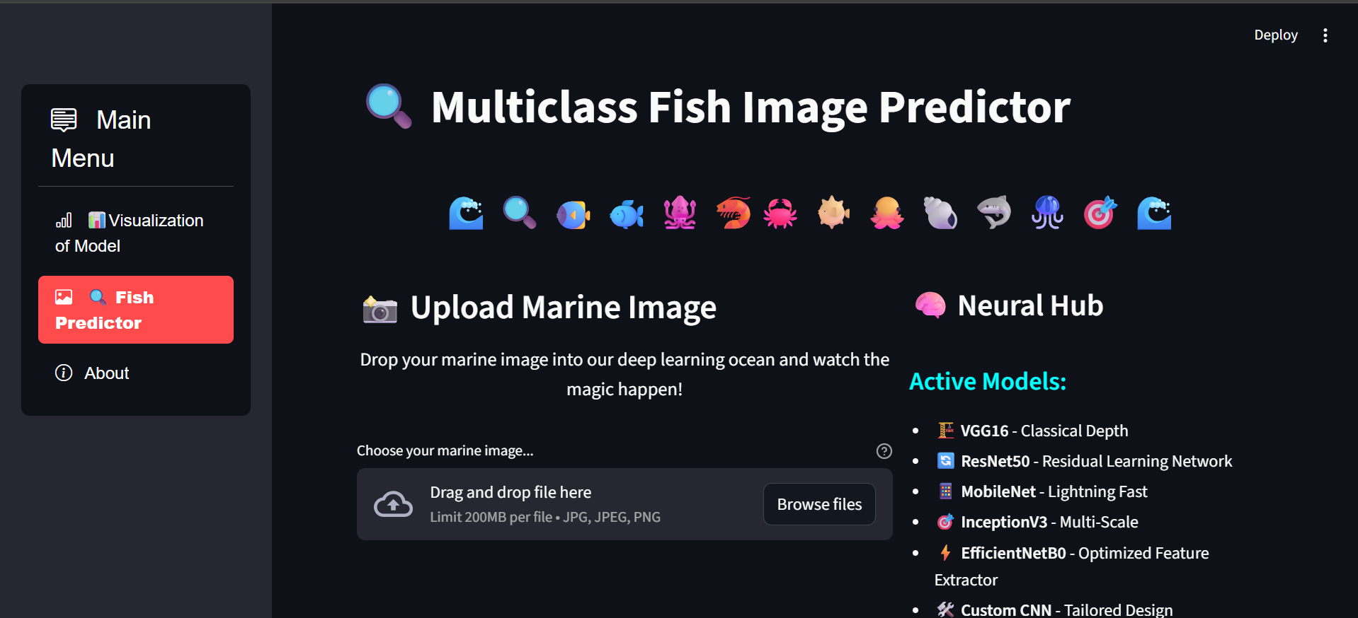
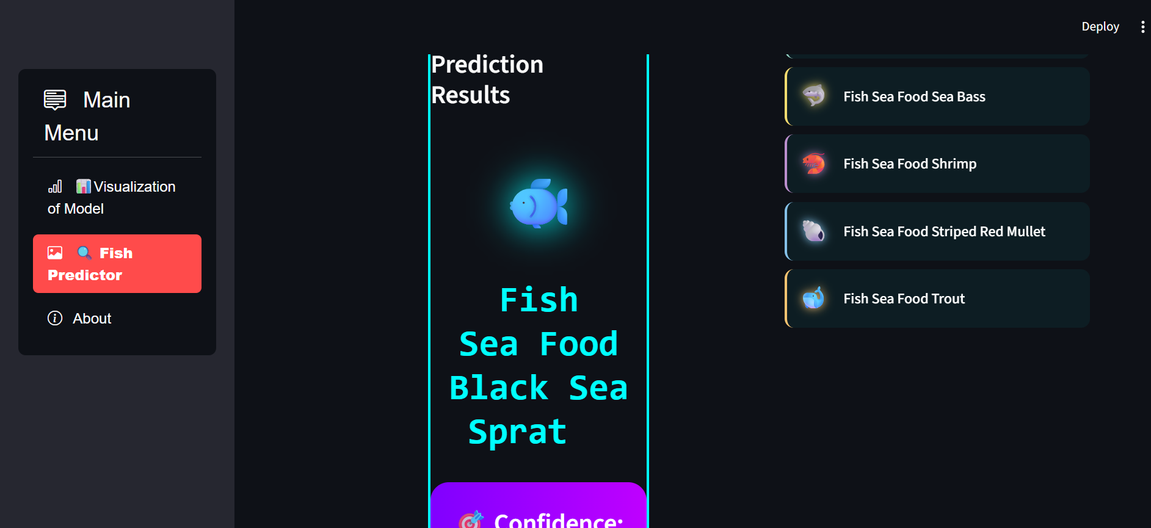
🔍 Multiclass Fish Image Predictor

Slide 8
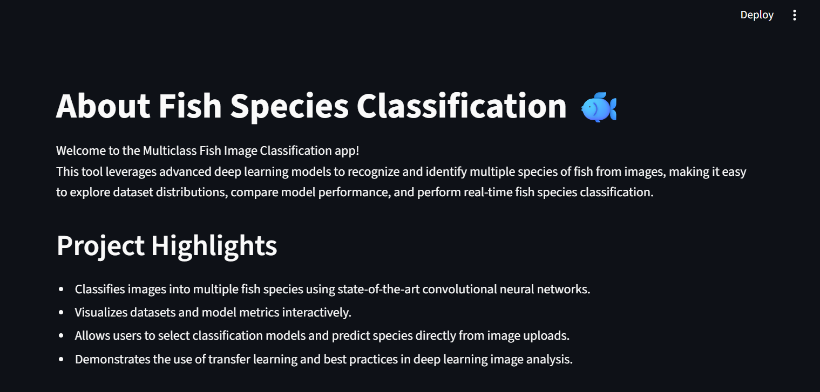
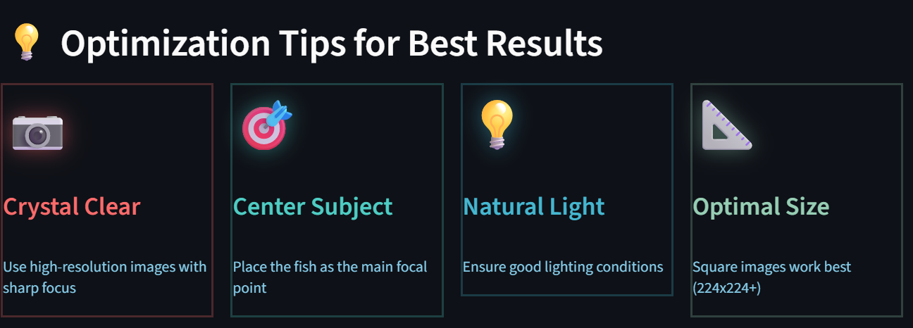
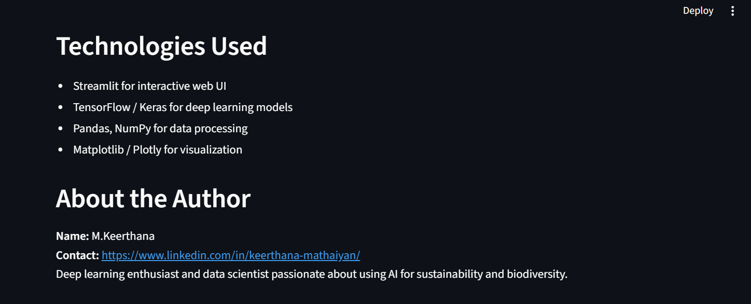
About

